Slide 1

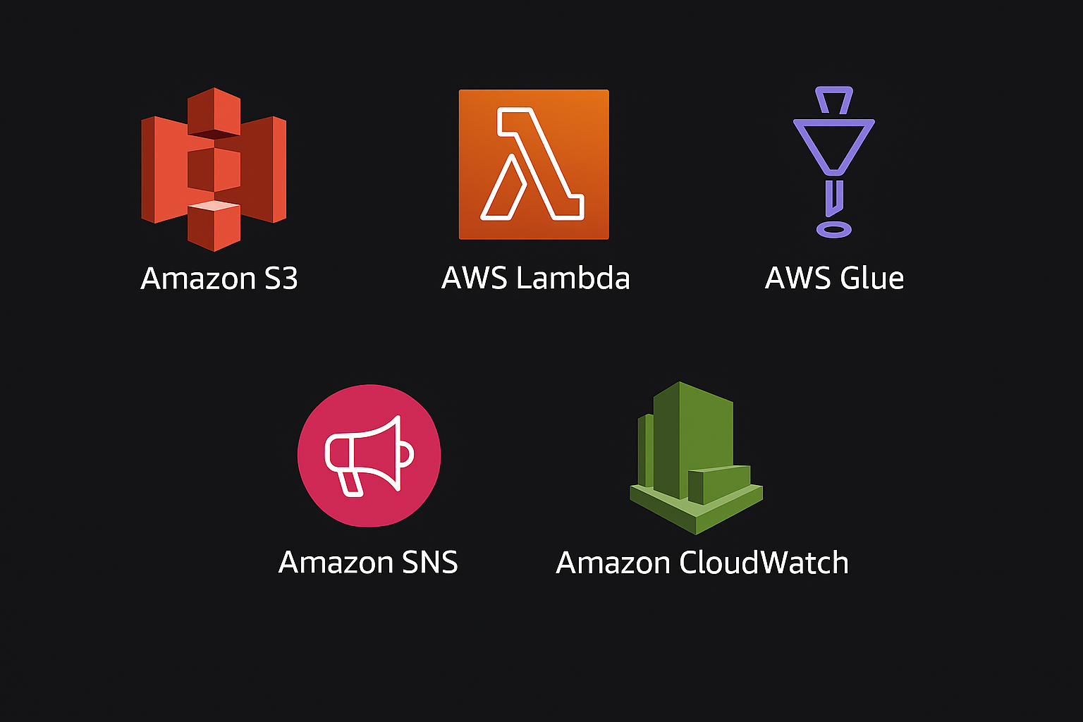
API DATA ANALYTICS

Slide 2
TEAM
Project Sponsor Mishra, Anuradha & Rohit Vijay
Project Manager Aishwarya Kulkrni & Purnima Sabharwal
Program Coordinator Mohammed Khader
Project Mentor Bhagyaraj Gopalam​
Developers Pranay Bollikonda, Koyna Jatwar, Vidhan Somkuwar, Katta RamShashank Reddy, Alekhya Lakshmi, Jayshree Gupta, Harika Kolluru, Sanjay Botta, Harsha Bellamkonda Venkata Sai Sriram, Avula Sangeetha, Nakka Saritha, Nerusupalli Meher Freiney, Rajoli ThrishaReddy, Akshat, Ashutosh Kumar, Soujit Das, Harshit Jajoo, Sagar Singh, Mani Raj Chaturvedi

Slide 3
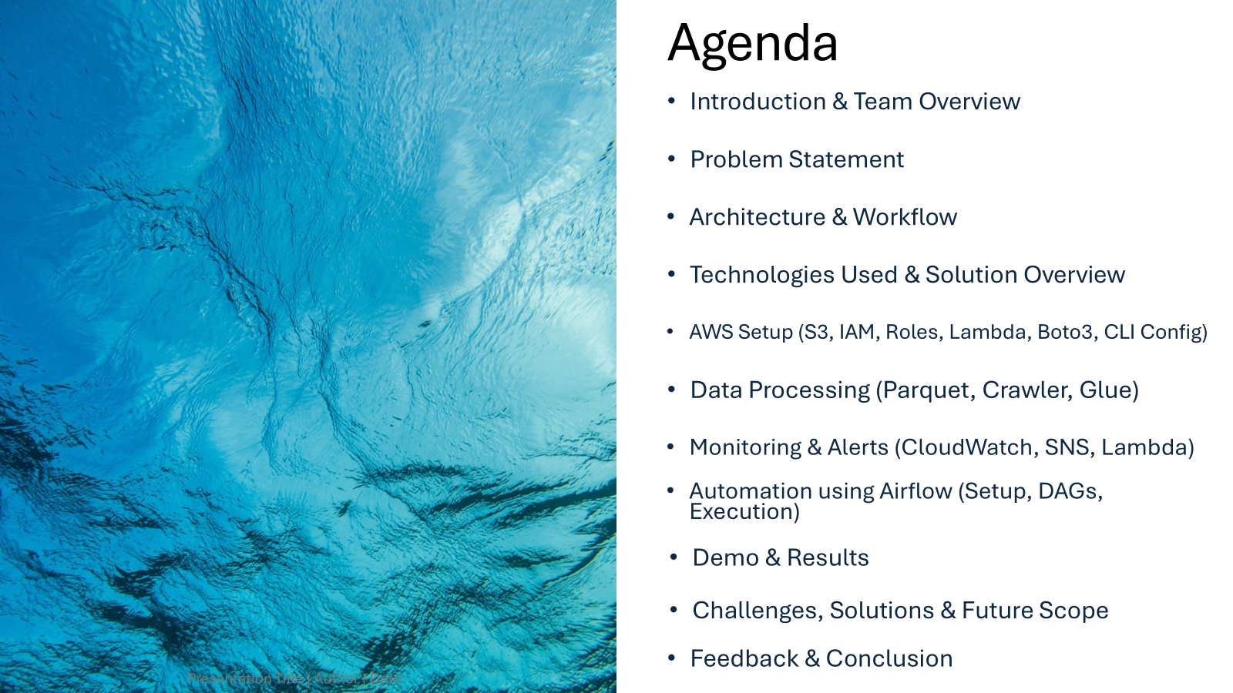

Slide 4
Problem Statement
Large volumes of semi-structured JSON data are generated from external APIs
This data cannot be directly used for analysis
Extracting, transforming, and loading API data into analytics platforms is complex and inefficient without automation
There is a need for a scalable data pipeline to:
Pull data from APIs
Process and structure the data
Load it into Amazon Athena for efficient querying and analysis

Slide 5
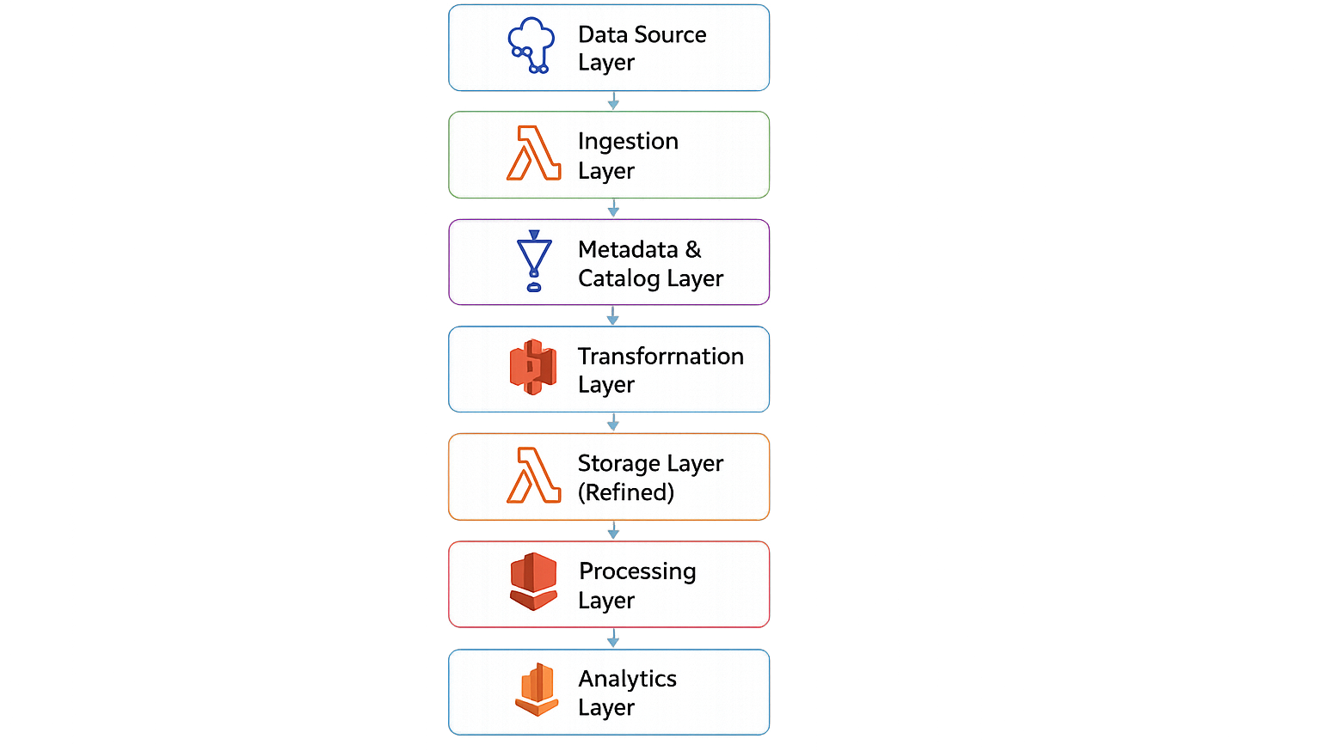
Architecture

Slide 6
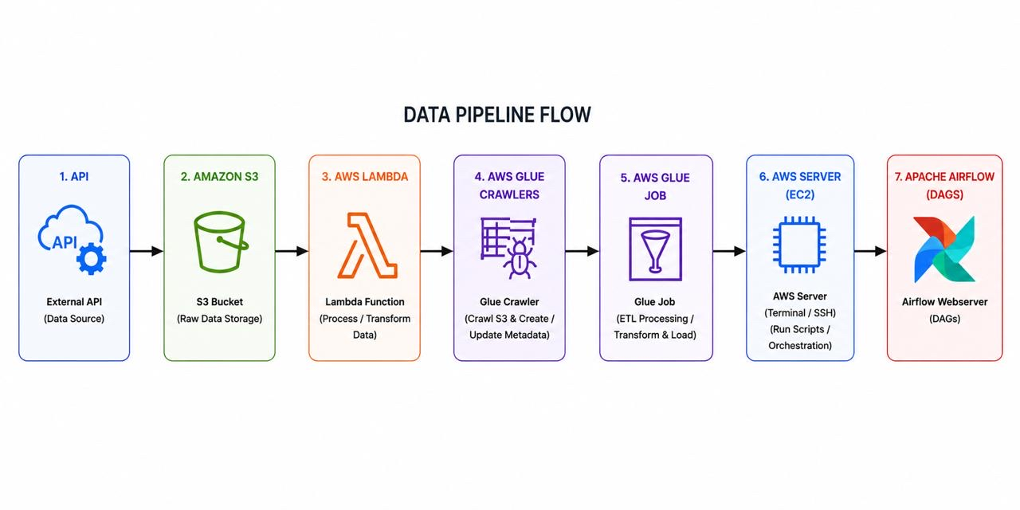
Workflow

Slide 7

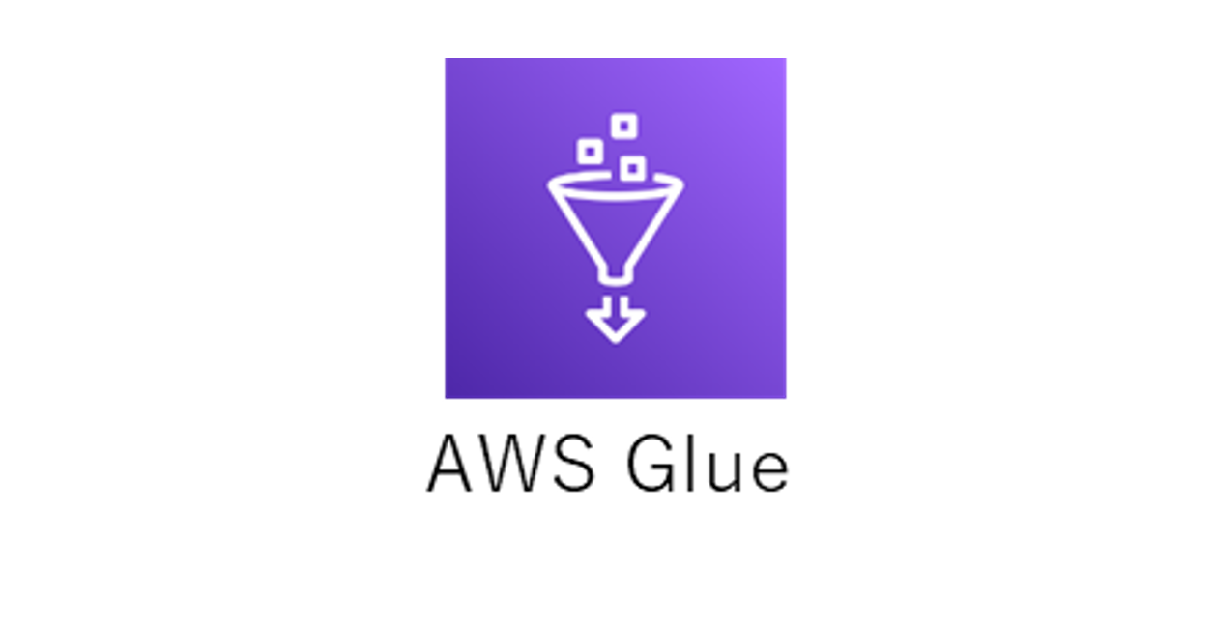


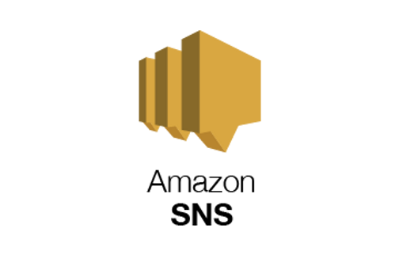

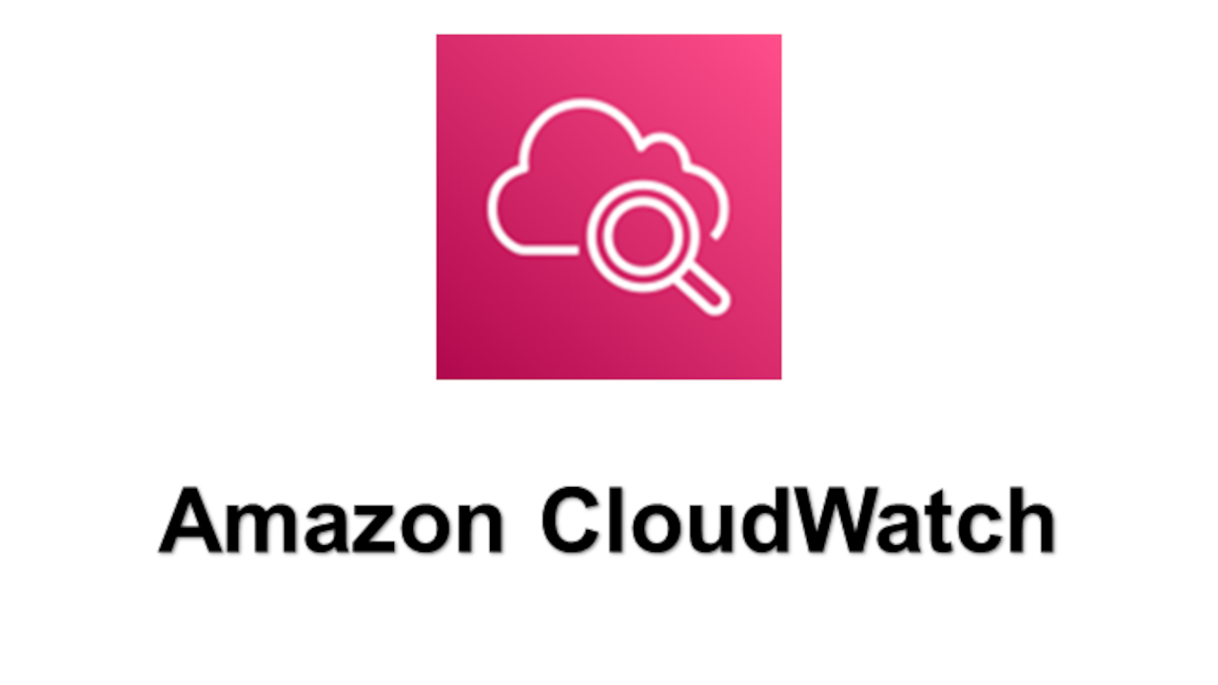
Technologies Used
COMPUTE: ORCHESTRATION:
STORAGE: MESSAGING:
MONITORING: SECURITY:

Slide 8
Solution Overview
Built an end-to-end ETL pipeline using AWS services and Airflow
Used Lambda to collect API data and store it in S3 in Parquet format
Processed and cleaned the data using AWS Glue with Spark
Stored the transformed data back in S3 for further usage
Used Airflow DAG to automate and manage the workflow execution
Queried the processed data using Athena for analysis

Slide 9
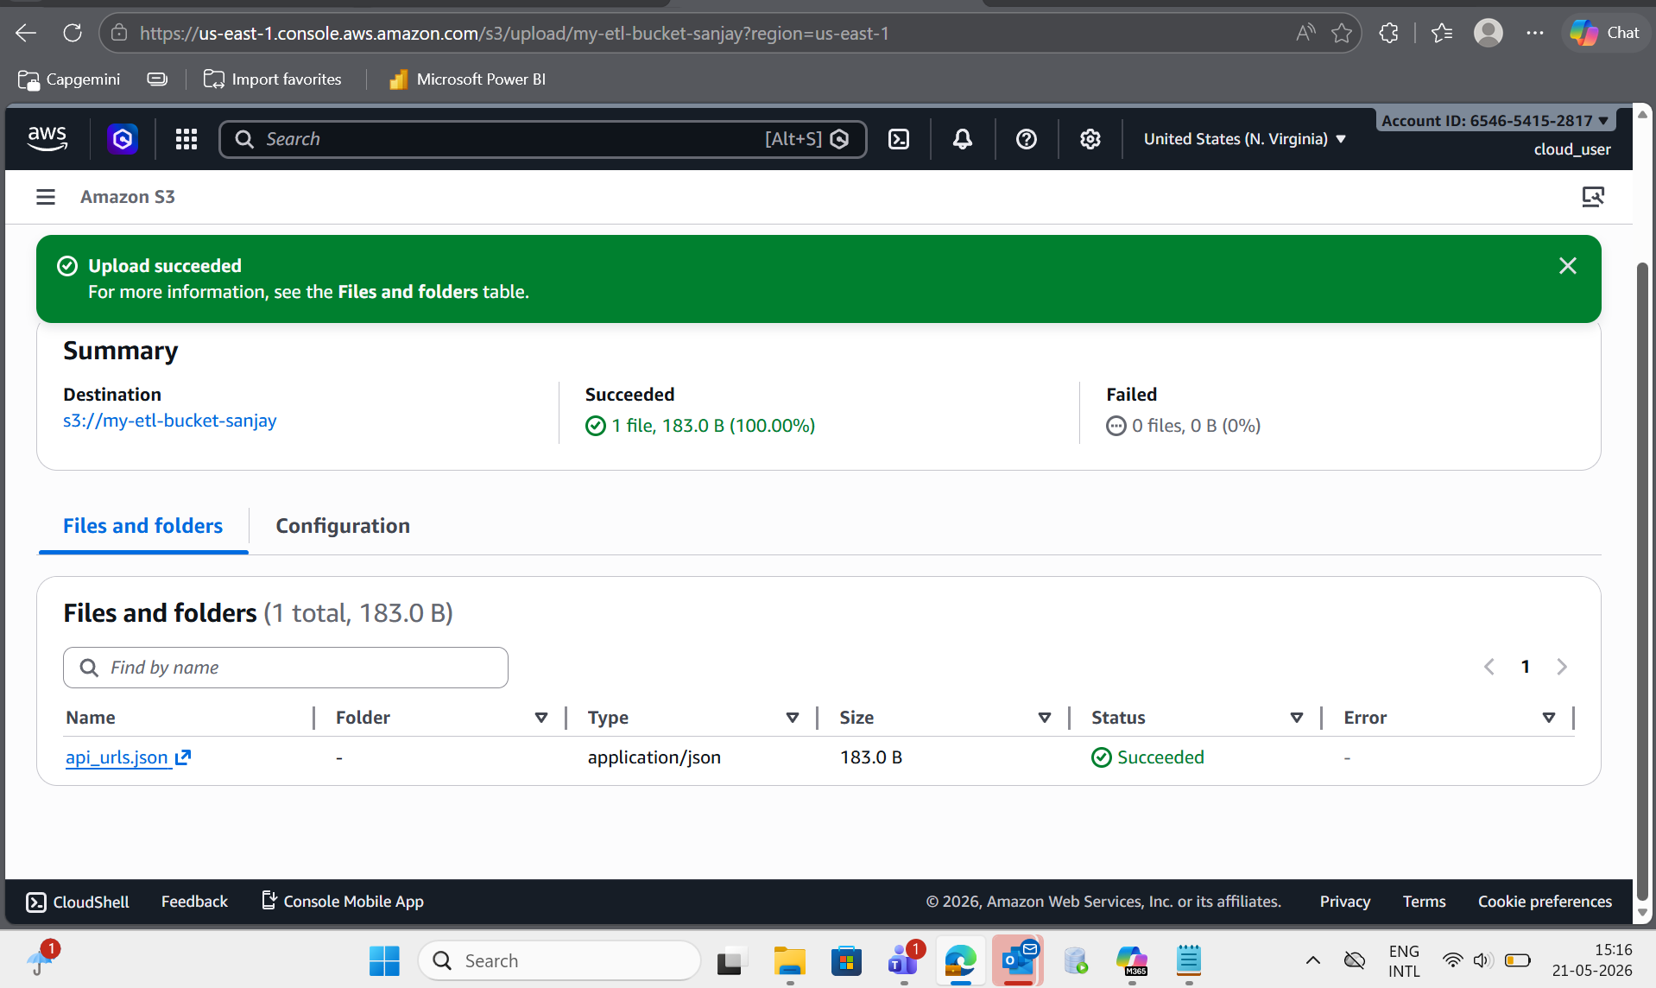
S3 Bucket
Used as a data lake storage for the pipeline
Stores API data in JSON format (input configuration)
Stores processed data in Parquet format
Provides high scalability, durability, and cost-effective storage
Maintains separate folders for:
Raw Data (API output)
Refined Data (Glue output)
Enables integration with:
Lambda (read/write data)
Glue (processing & transformation)
Athena (querying data)

Slide 10
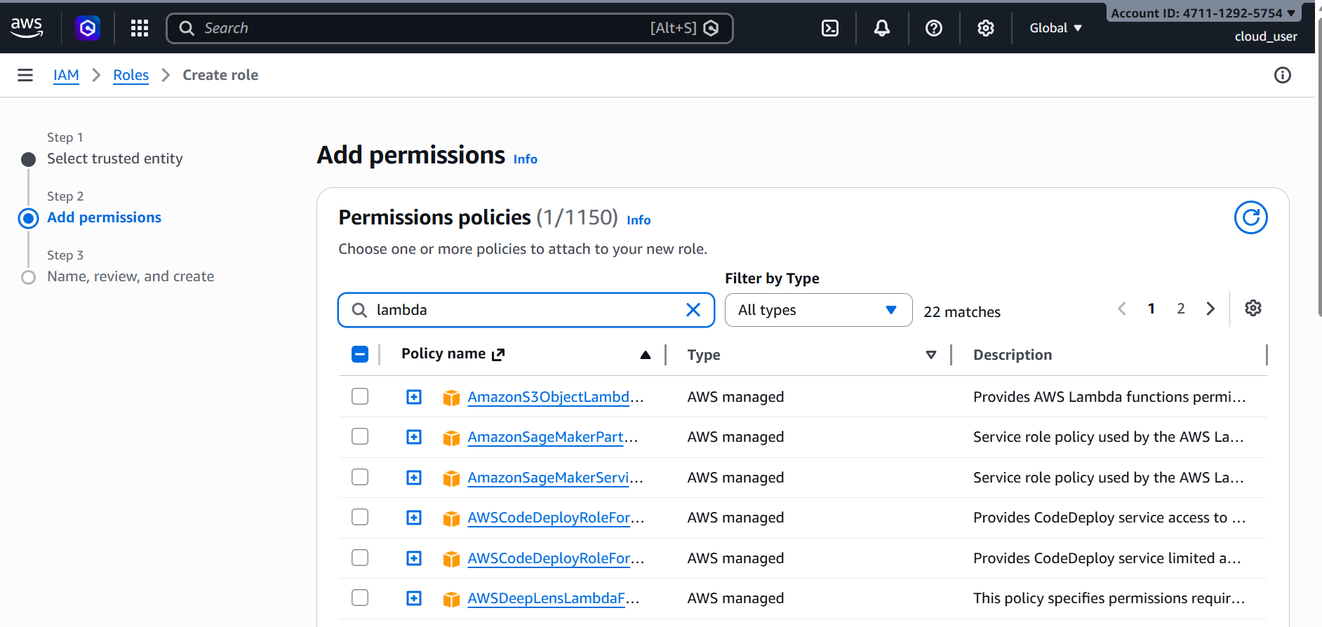
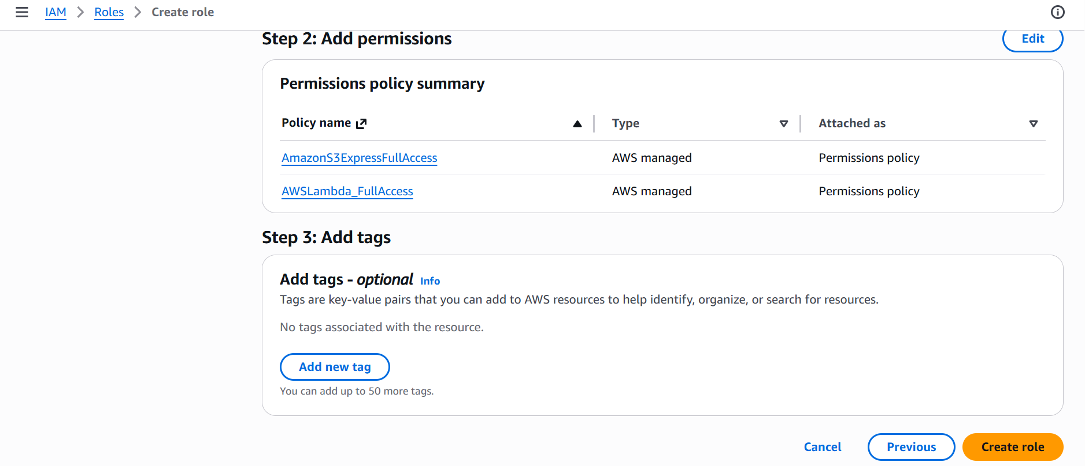
IAM (Identity and Access Management) :
IAM is an AWS service that helps you securely control access to AWS resources.
An IAM Role is a set of permissions that allow AWS services to perform actions on your behalf.
Here we have used this services:
AWS Lambda
S3Lambda
Glue
CloudWatch
SNS

Slide 11

Creating Lambda Functions
What does these functions do
To change API JSON file to Parquet file
To process the logs from Cloudwatch
To send the SNS notification

Slide 12
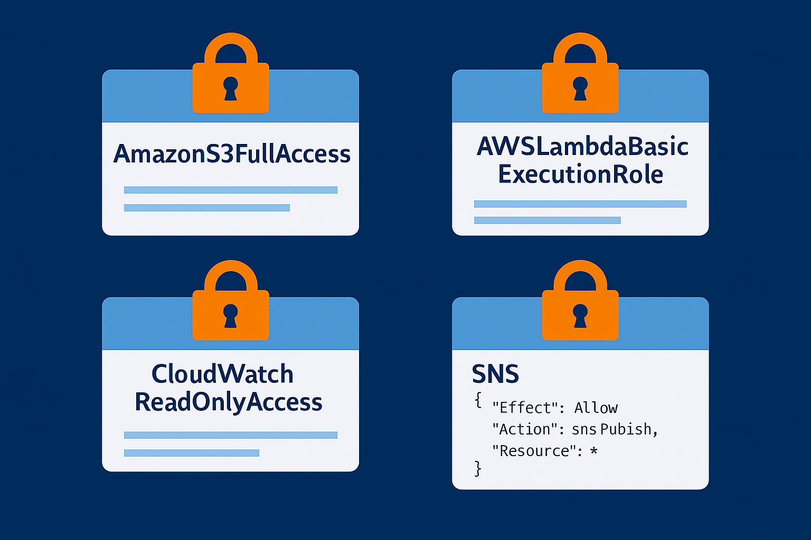
Attaching the Role
Role has the set of permissions for the functions
Permission | Why it is needed
AmazonS3FullAccess | Read/write files from S3
AWSLambdaBasicExecutionRole | Write logs
CloudWatchReadOnlyAccess | Read logs/metrics
SNS Publish Policy | Send notifications

Slide 13
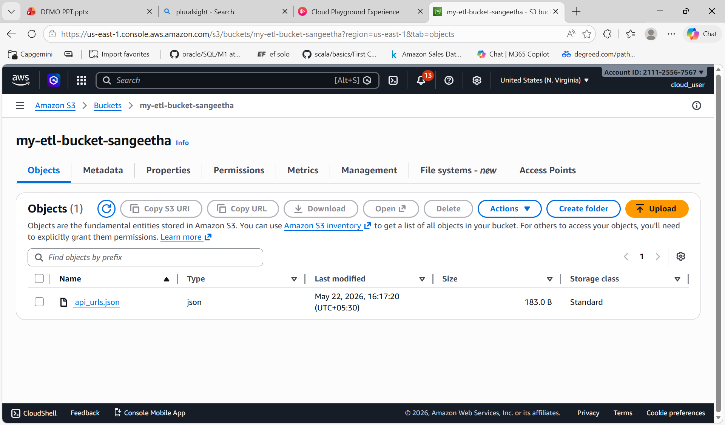
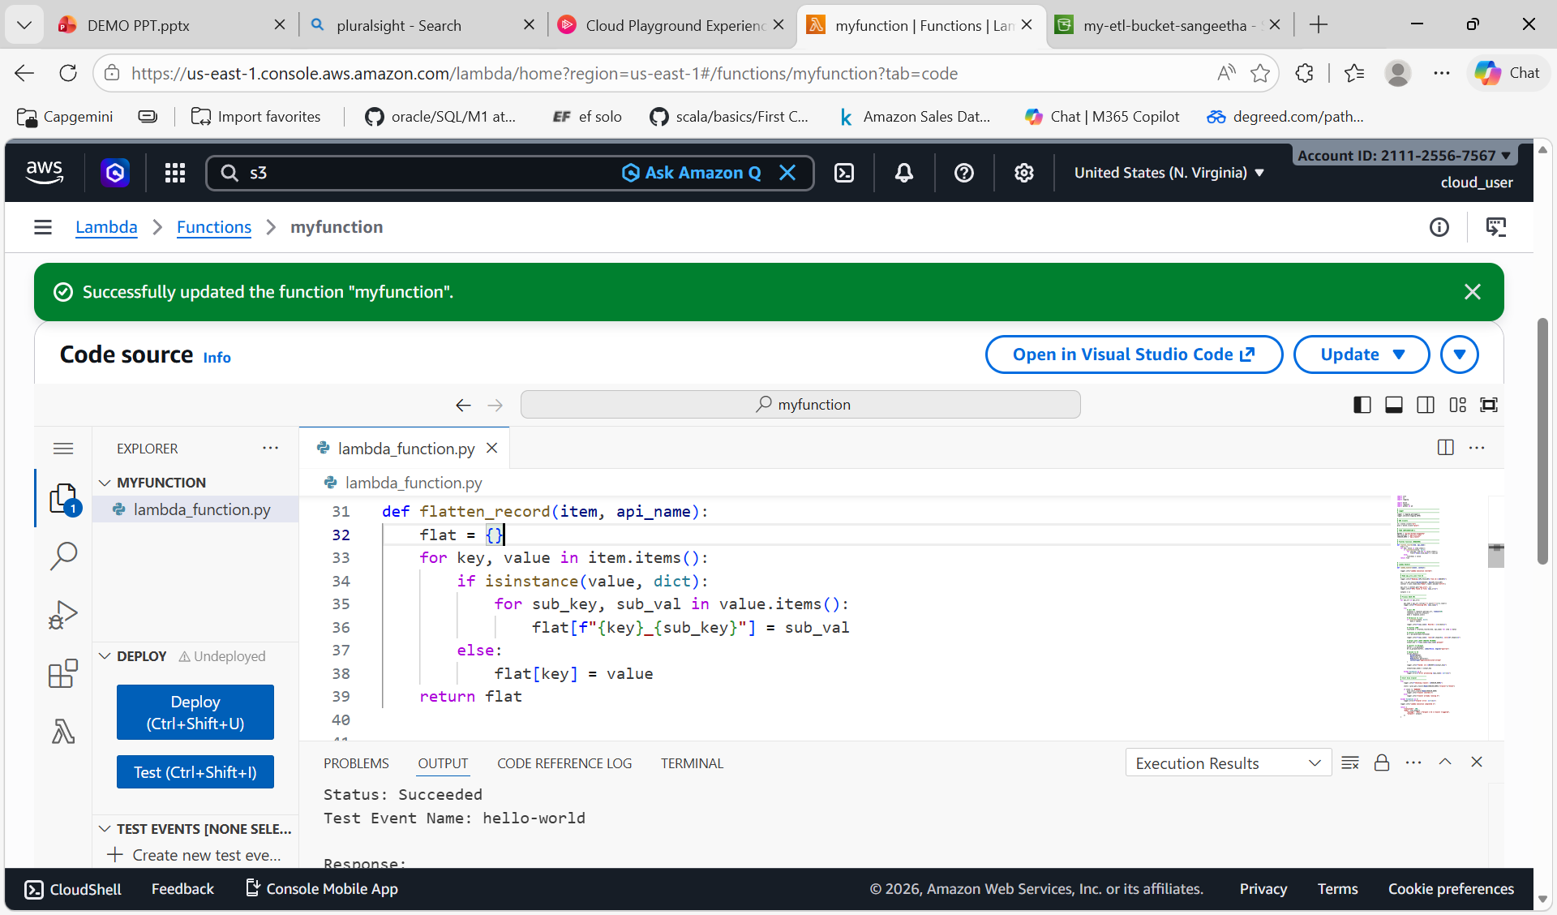
API Configuration & Data Ingestion using Lambda
The first image shows the Amazon S3 bucket , where the api_urls.json file is stored and used as input for the ETL process.
Lambda Function-1 to Extract API URLs from S3
The second image shows the AWS Lambda function code, which reads the JSON file from S3 and processes the API URLs.

Slide 14
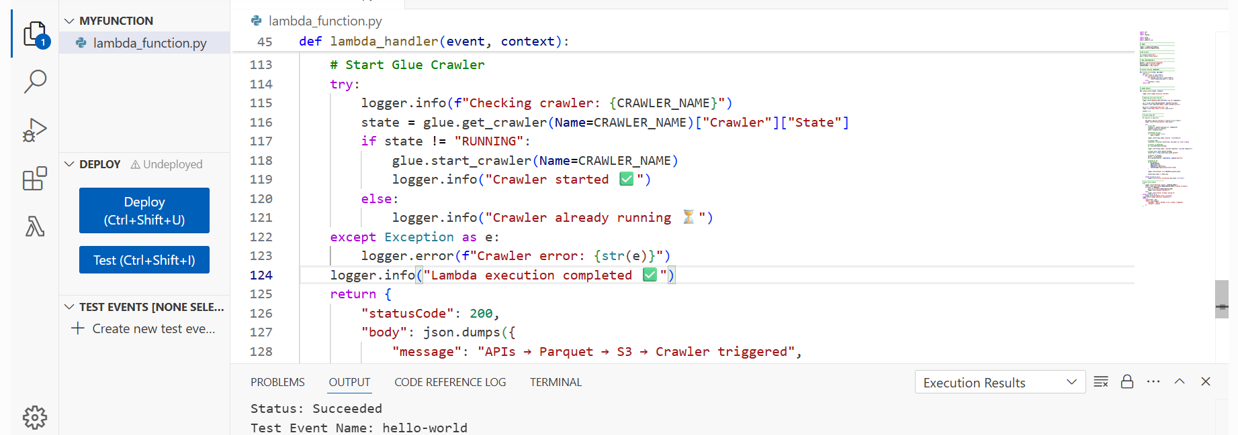
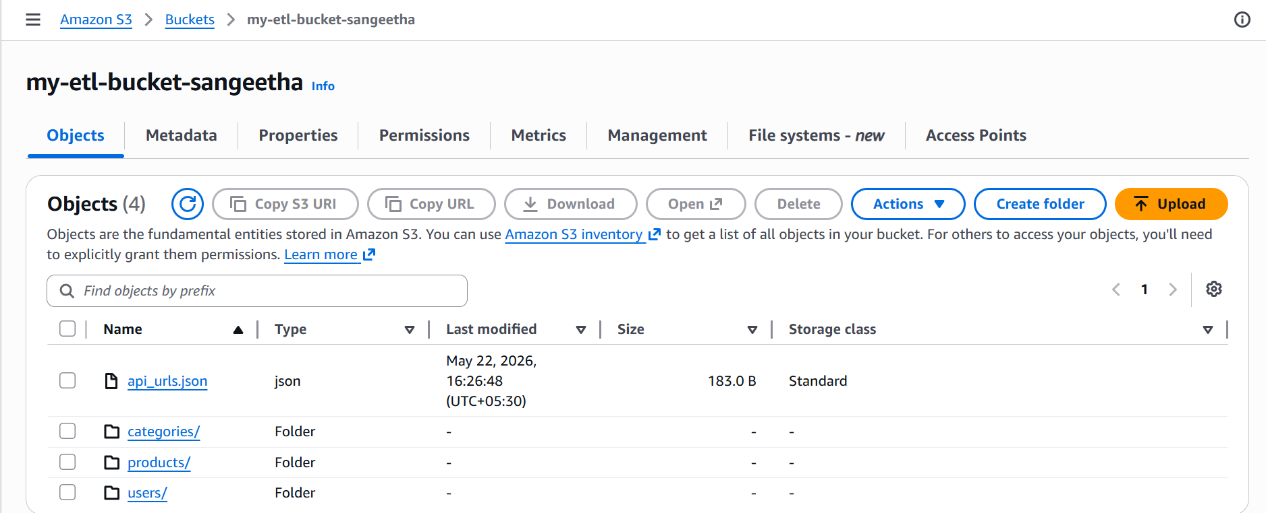
The image shows the AWS Lambda function code, which checks whether the Glue Crawler is running or not, and starts it if needed.
After the Lambda function runs, it processes API data and stores outputs such as categories, products, and users into S3 bucket .

Slide 15
What is Parquet Format
Columnar Storage 📶
Analytics Optimized 🚀
PARQUET
FORMAT
Storage Optimization 💾
High Performance ⚡

Slide 16
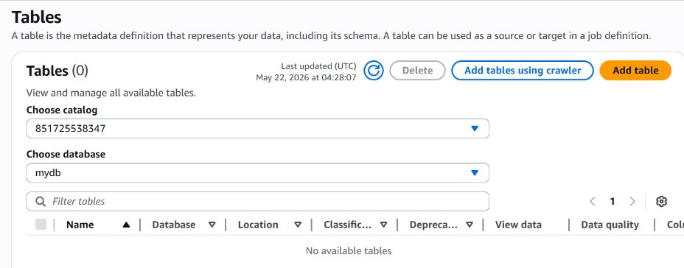
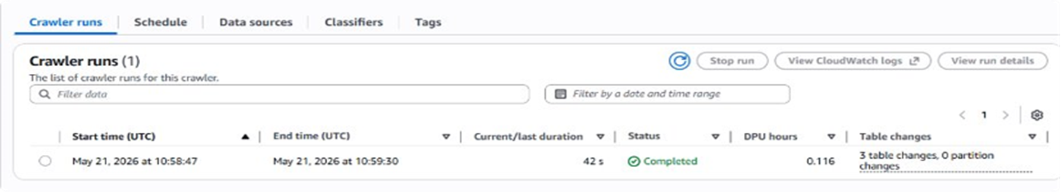
Crawler — Overview & Usage
Before running crawler there are no tables in the database

Slide 17
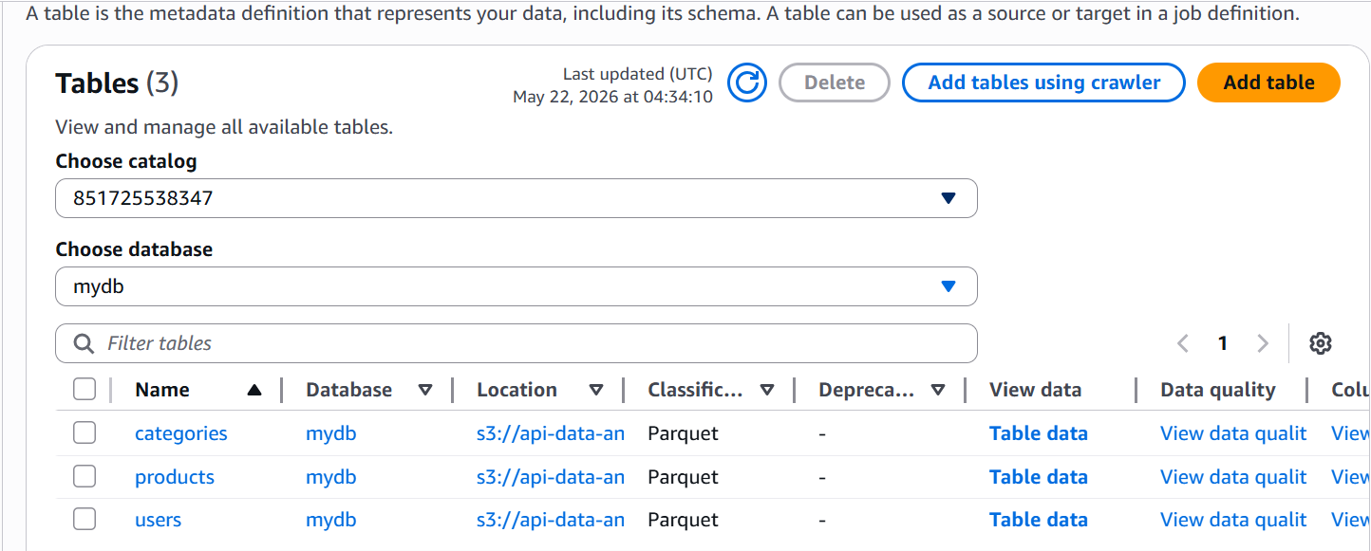
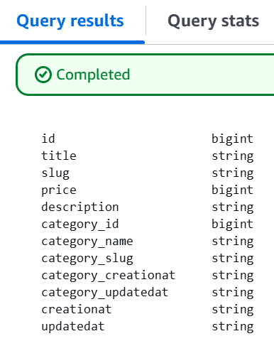
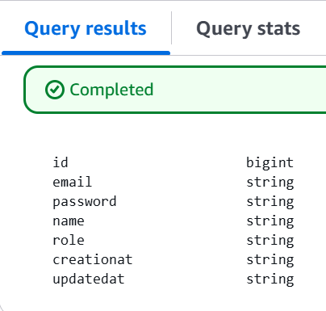
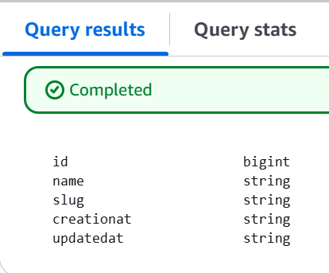
After Running The Crawler
Categories Schema
Products Schema
Users Schema

Slide 18

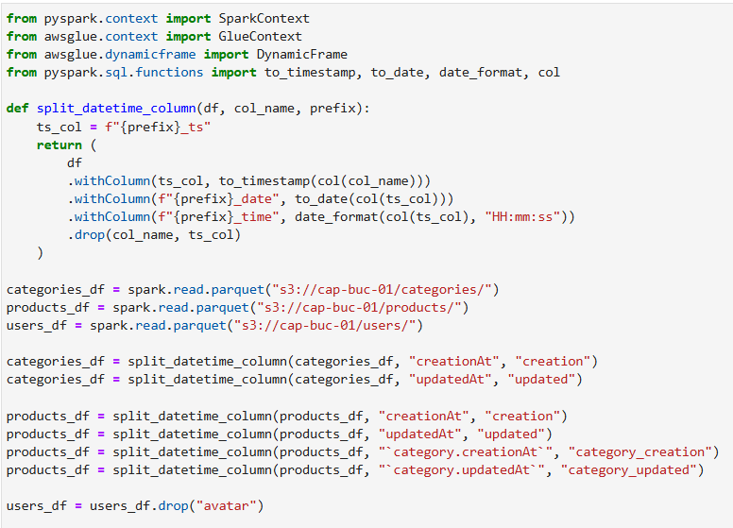
Serverless ETL service by Amazon web Services.
Extracts, transforms, and loads data automatically.
Cleans and prepares raw data for analytics.
Integrates with S3, Crawlers, Athena, and Lambda.

Slide 19
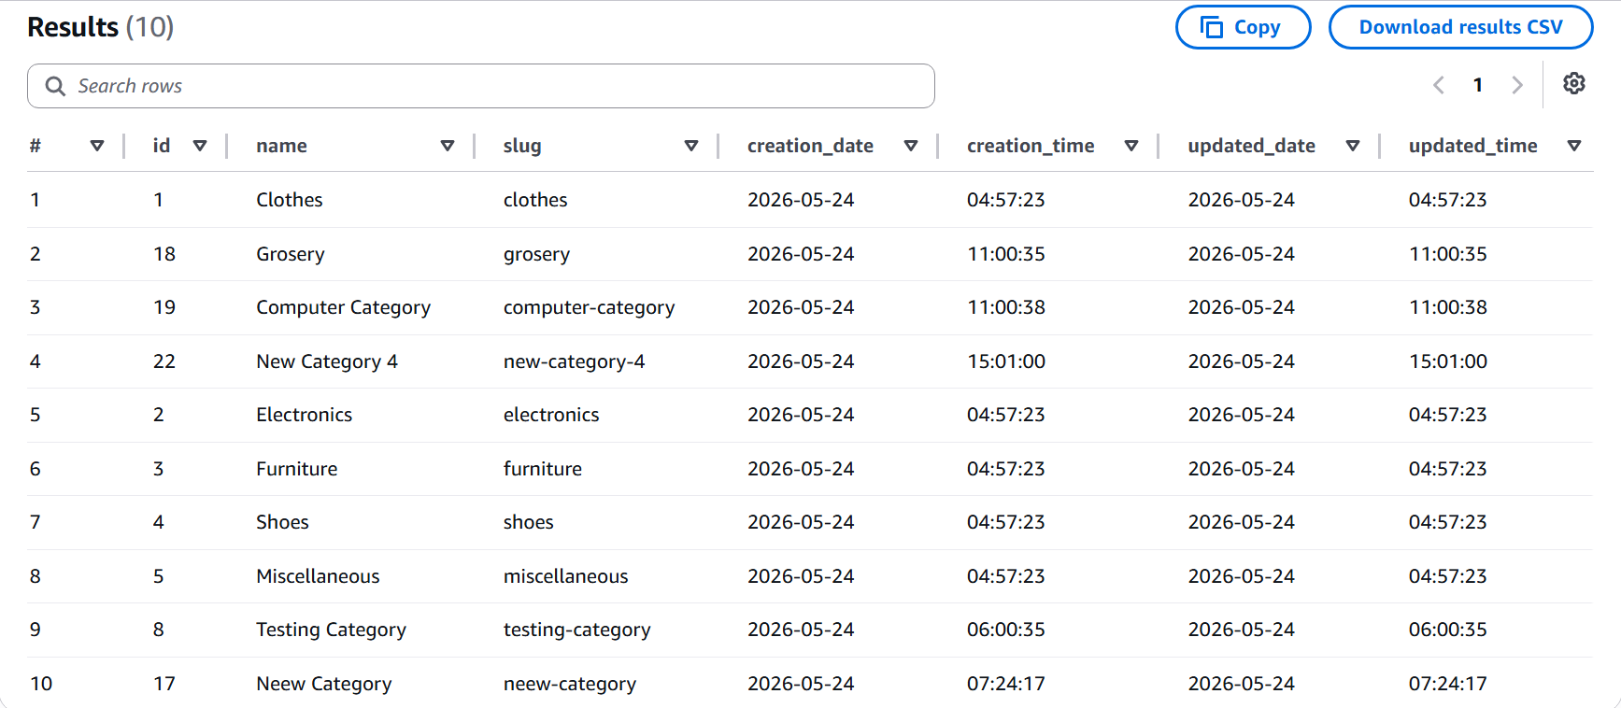
After transformation, cleaned data is stored into revised DB
Athena Query 1: SELECT * FROM updated_categories limit 10;

Slide 20
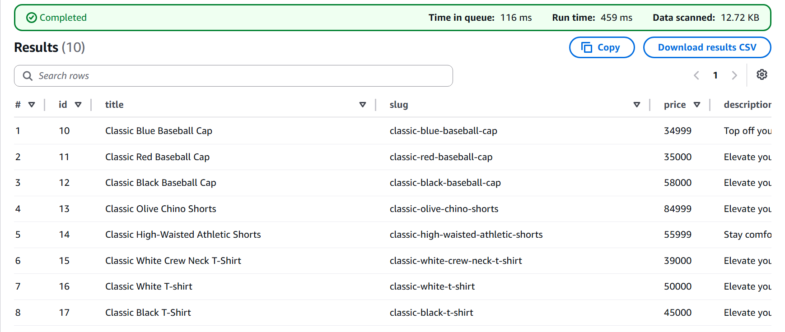
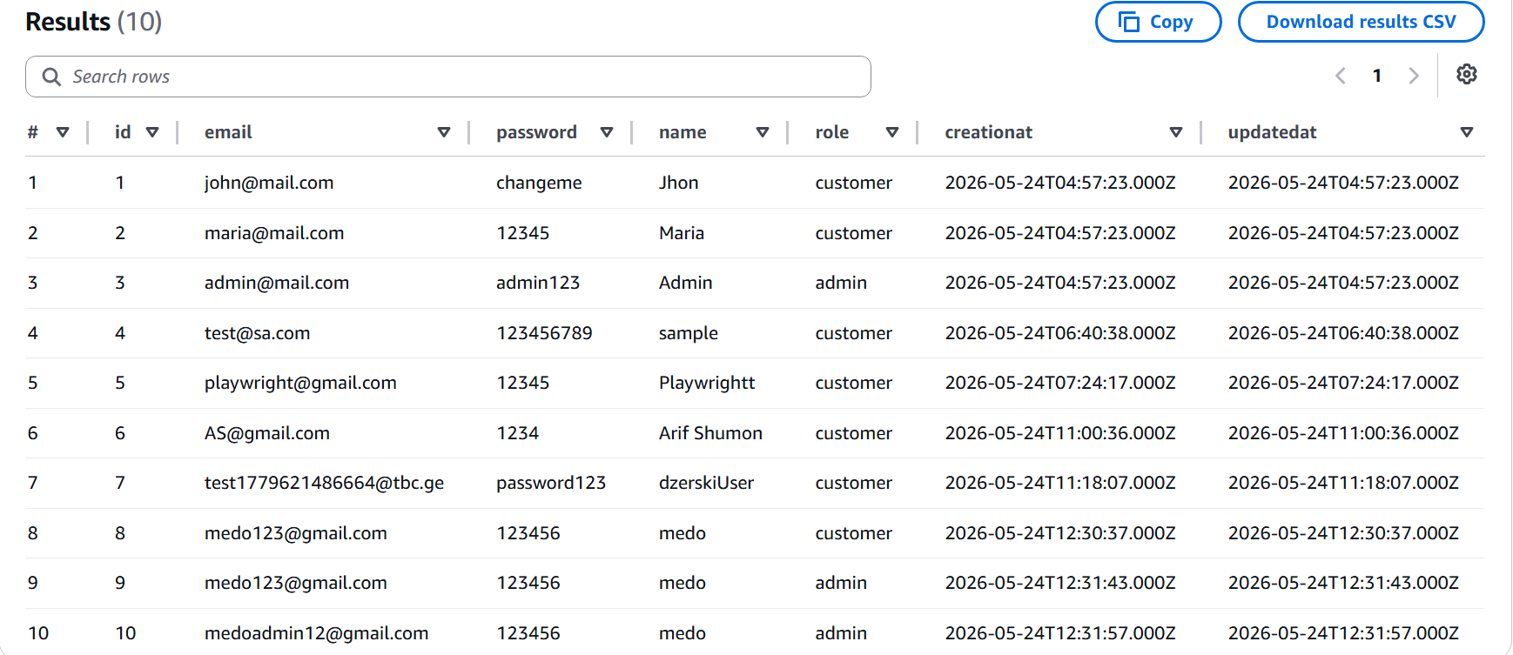
Athena Query 3: SELECT * FROM updated_users limit 10;
Athena Query 2:
SELECT * FROM updated_products
limit 10;

Slide 21
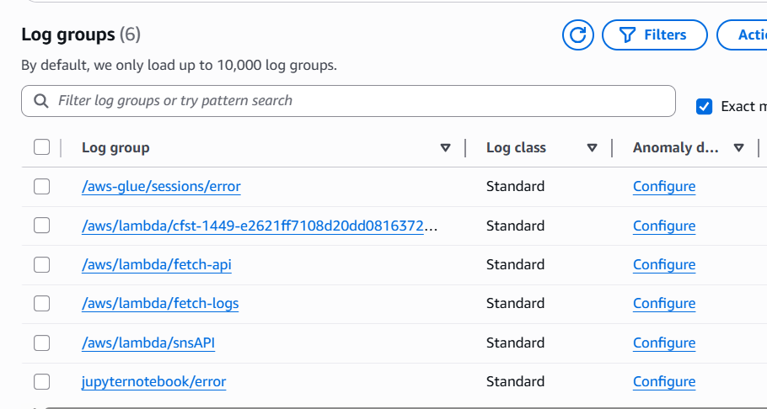
CloudWatch Logs
Amazon CloudWatch is a monitoring service that collects and stores logs from AWS resources like Lambda, Glue.
It organizes logs into log groups and log streams for easy tracking and analysis.
CloudWatch helps identify issues by capturing ERROR logs, timestamps, and execution details.
These logs can be used by Lambda to process errors and trigger alerts using services like SNS.

Slide 22
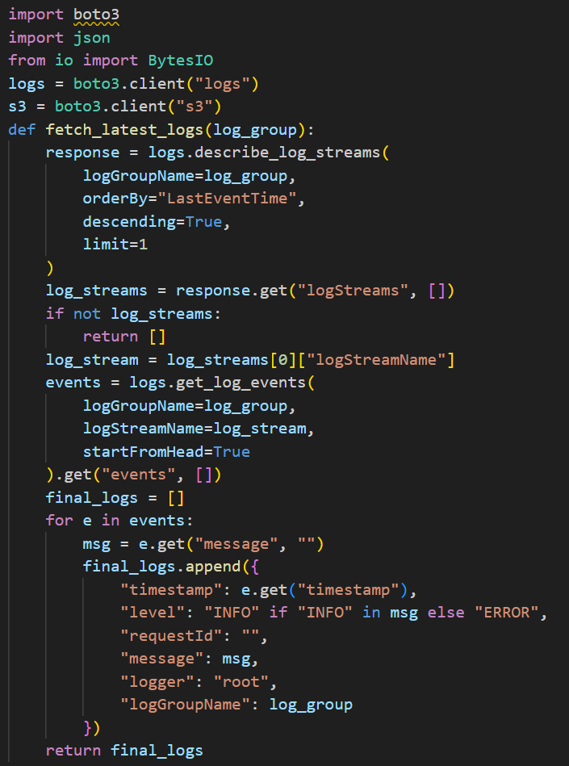
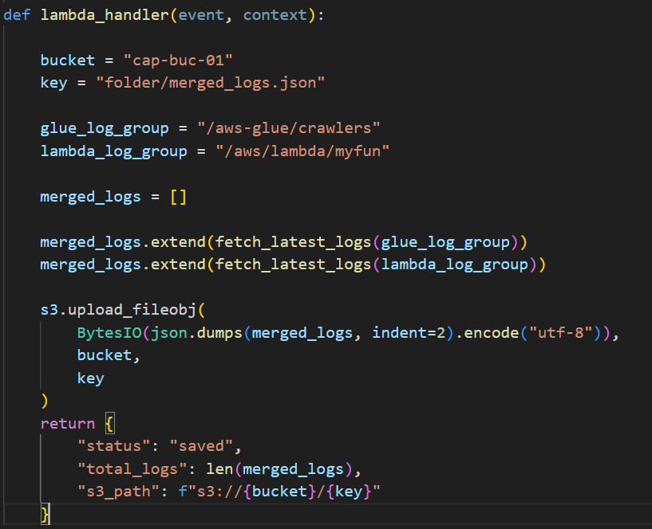
Lambda 2: Saving Logs from Crawler and Lambda
This Lambda function collects logs from AWS CloudWatch.
It retrieves logs from two sources:
Glue Crawler logs
Lambda function logs
It identifies the most recent log stream from each log group.
It reads all log events from that latest stream.
Each log is formatted into a structured JSON format.
Logs are classified based on message content (INFO or ERROR).
Logs from both sources are combined into a single dataset.
The merged logs are then uploaded to an S3 bucket.
This enables centralized logging, easy access, and monitoring.

Slide 23
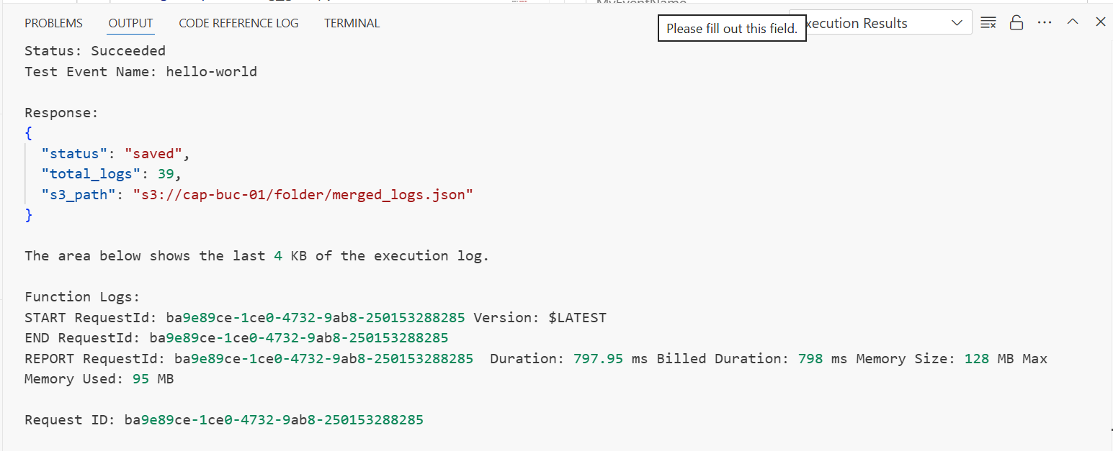
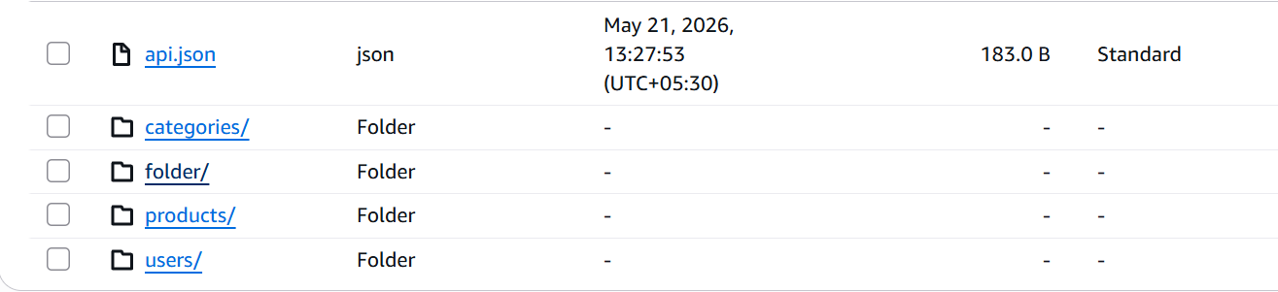
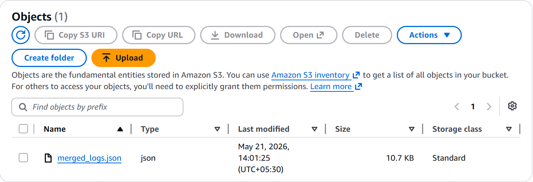
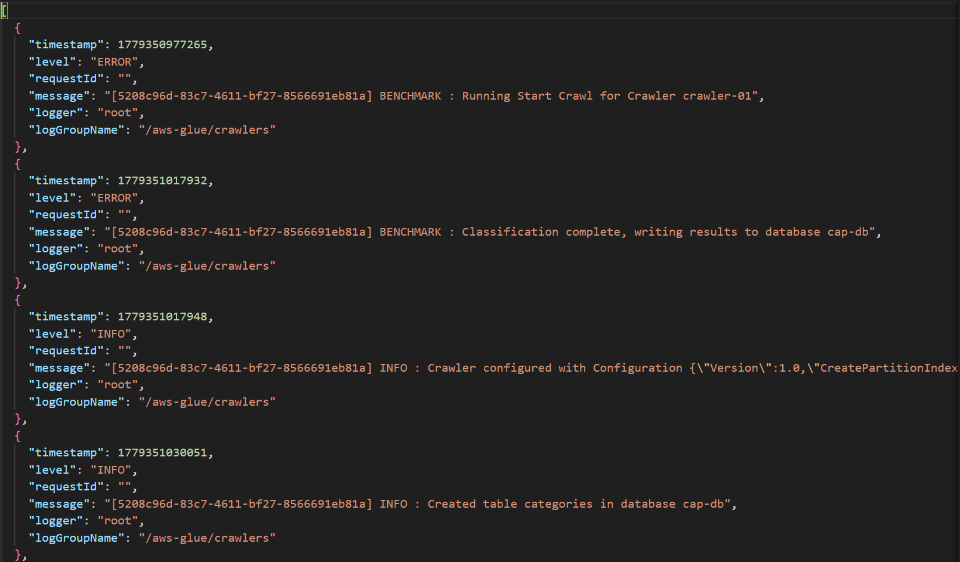
As shown in Image 1, the Lambda function executed successfully and generated the merged logs.
In Image 2, the S3 bucket displays the folder where the output file merged_logs.json is stored along with other datasets.
In Image 3, the merged log file contains structured details such as timestamp, log level, message, logger, and log group name.
This file is further used to send notifications via Amazon SNS, helping track the status of the Glue Crawler and Lambda execution.

Slide 24
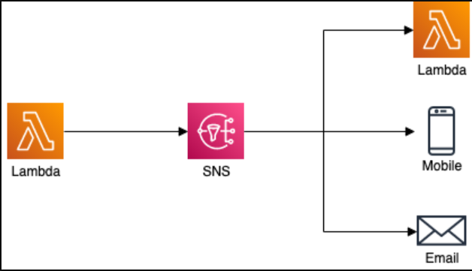
Amazon SNS
What is SNS ?
Amazon SNS is a notification service
Uses Publish → Subscribe model
Sends messages to multiple systems at once
Pipeline Flow:
Error occurs in system
Message sent to SNS Topic
SNS triggers:
Email → User receives error message
Lambda 3 → Handles error processing
Why SNS ?
Instant notifications
Parallel processing
Decouples services

Slide 25
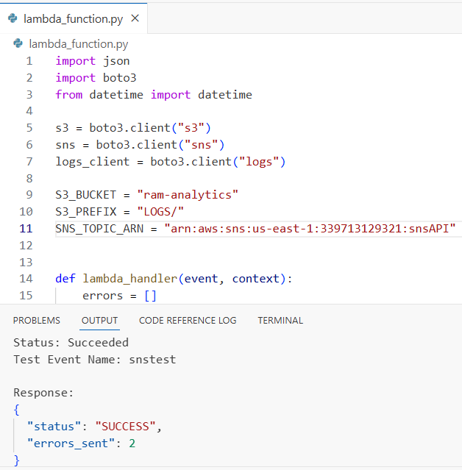
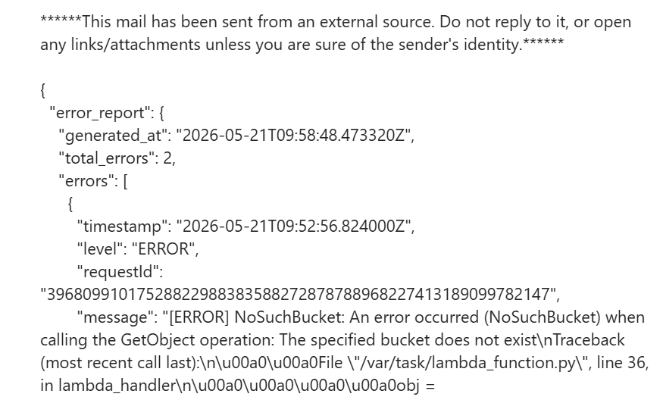
Lambda3 Error Report
Code for lambda3 where we have to provide topic ARN of our subscription and bucket name
Error Report received through email

Slide 26
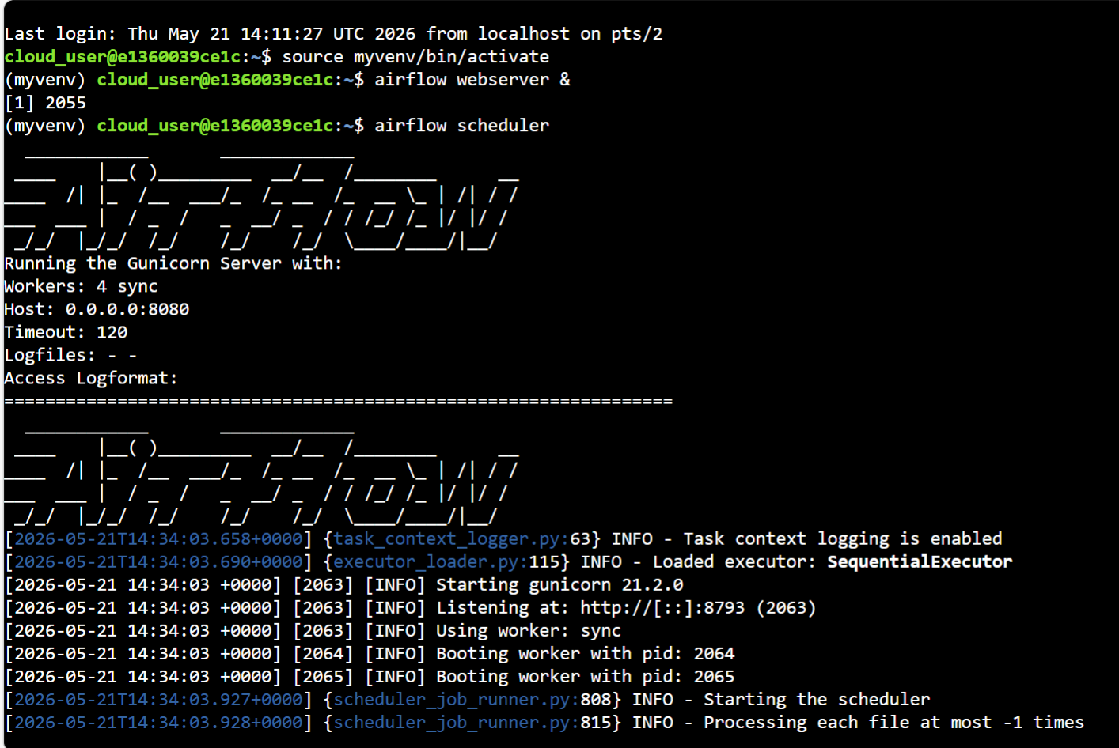
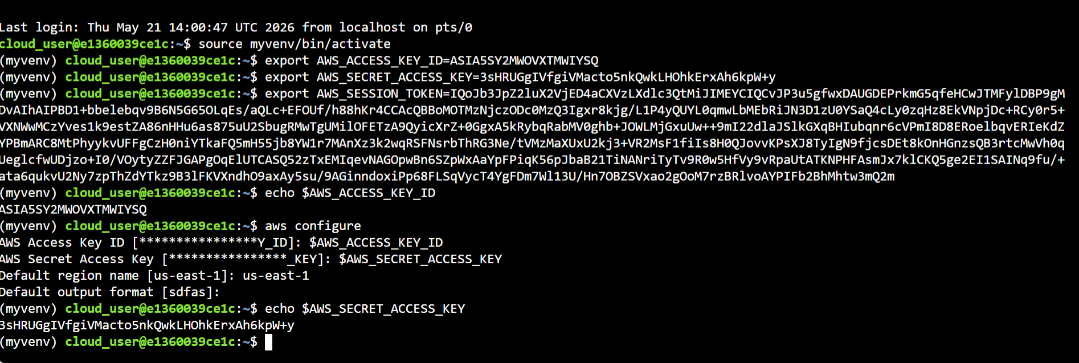
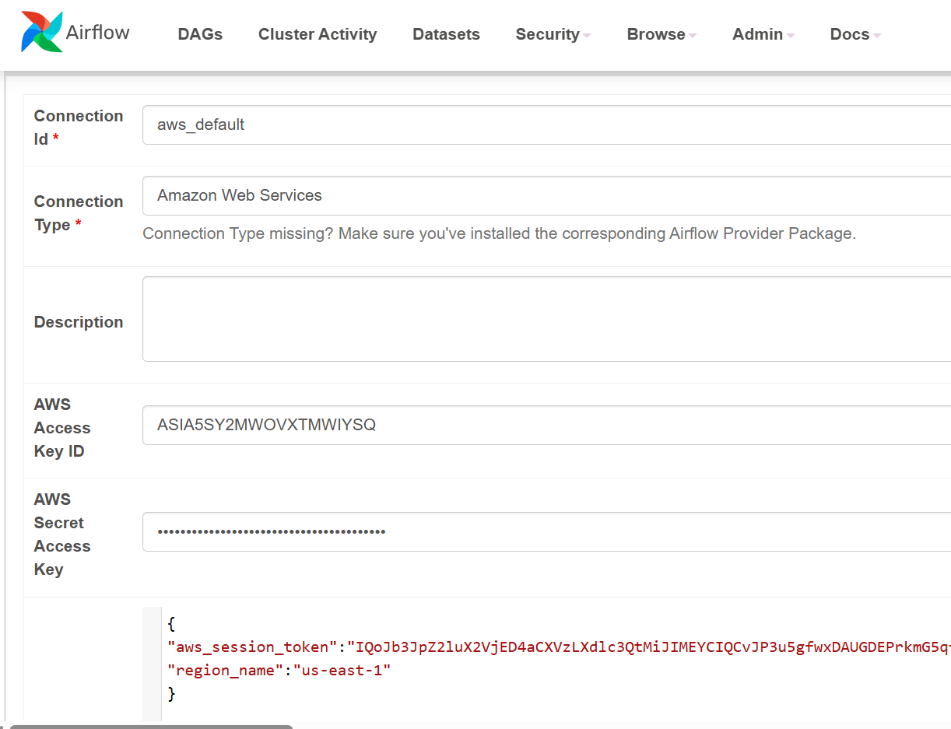
Server Creation & Airflow Setup
• Activated Python virtual environment (myvenv)
• Started Airflow webserver (port 8080) and scheduler
• Initialized Gunicorn server with multiple workers
• Verified Airflow is running and accessible via browser
• Scheduler started processing workflows (DAGs)
AWS Configuration (CLI Setup)
• Exported AWS_ACCESS_KEY_ID and AWS_SECRET_ACCESS_KEY
• Configured AWS using aws configure
• Set default region to us-east-1
• Verified credentials from terminal
Airflow AWS Integration
• Created Airflow connection: aws_default
• Added AWS Access Key and Secret Key
• Configured session token and region
• Enabled Airflow to interact with AWS services

Slide 27
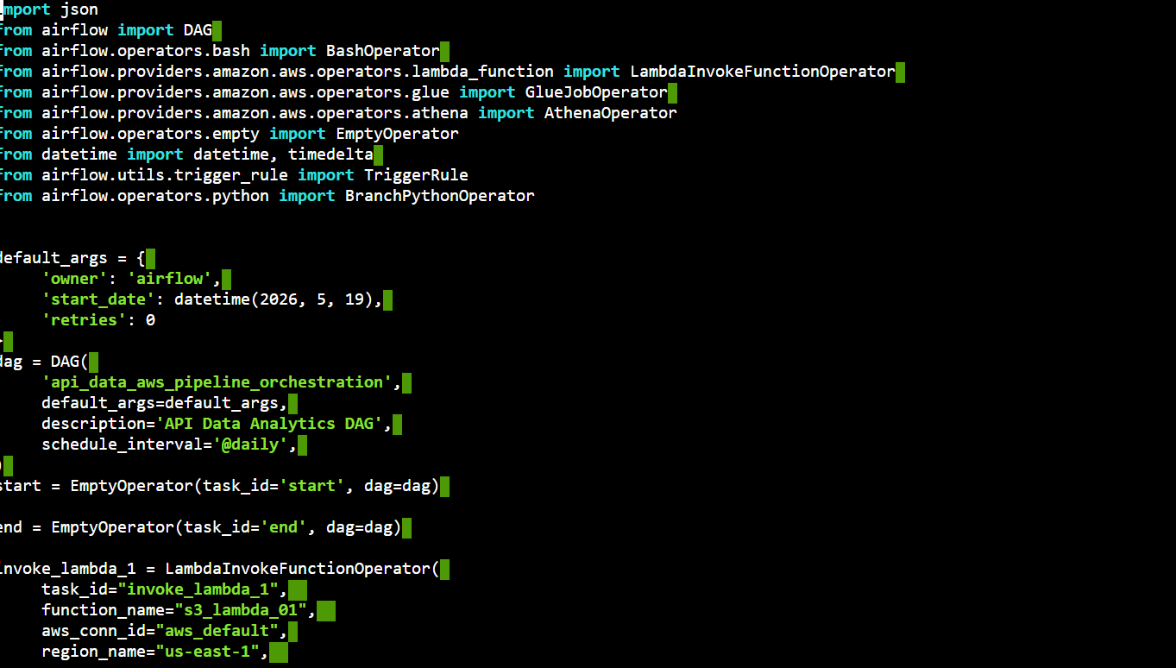
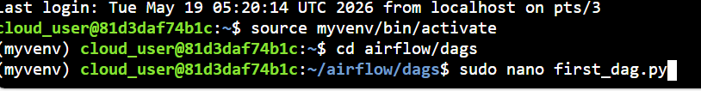
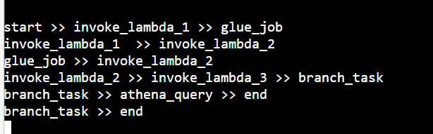
What is DAG?
• DAG (Directed Acyclic Graph) defines workflow structure in Airflow
Represents tasks and their dependencies
Ensures controlled and sequential execution
DAG Folder
DAG files are stored inside the Airflow DAGs directory
Airflow automatically detects .py files placed in this folder
DAG Code

Slide 28
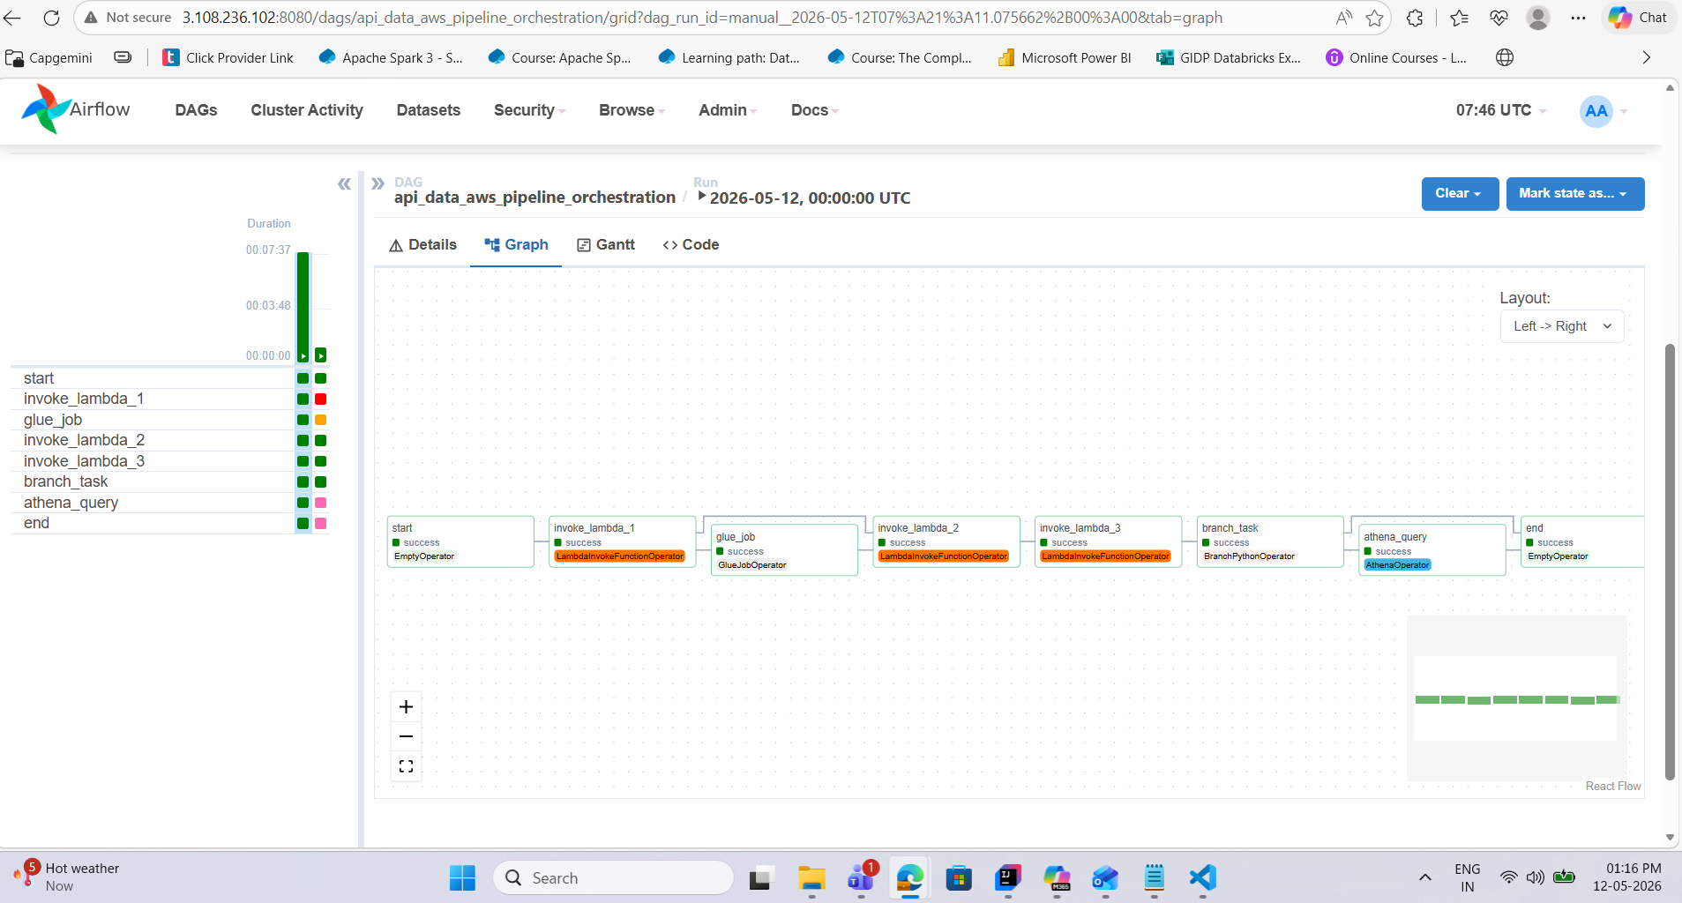
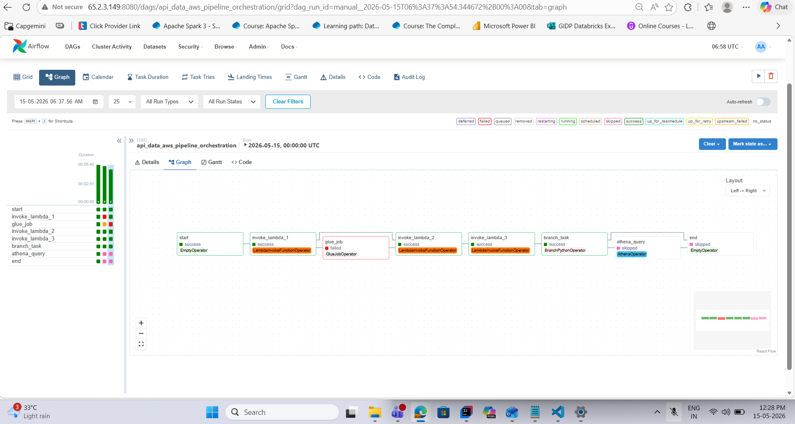
DAG Graph for success and failure
Success Graph
Failure Graph

Slide 29
Live Demo

Slide 30
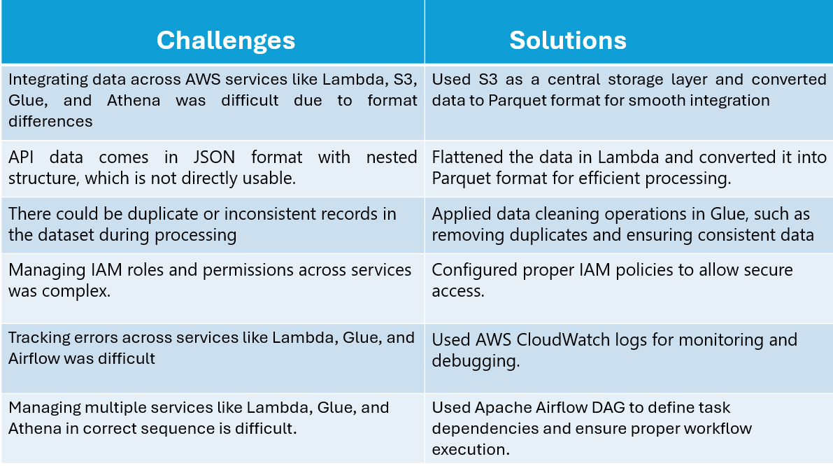

Slide 31
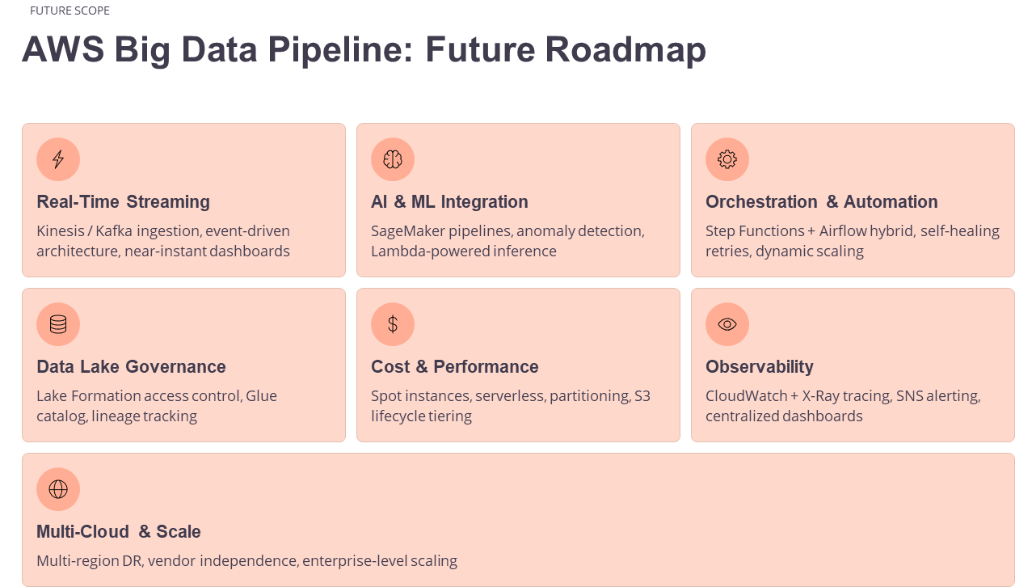

Slide 32
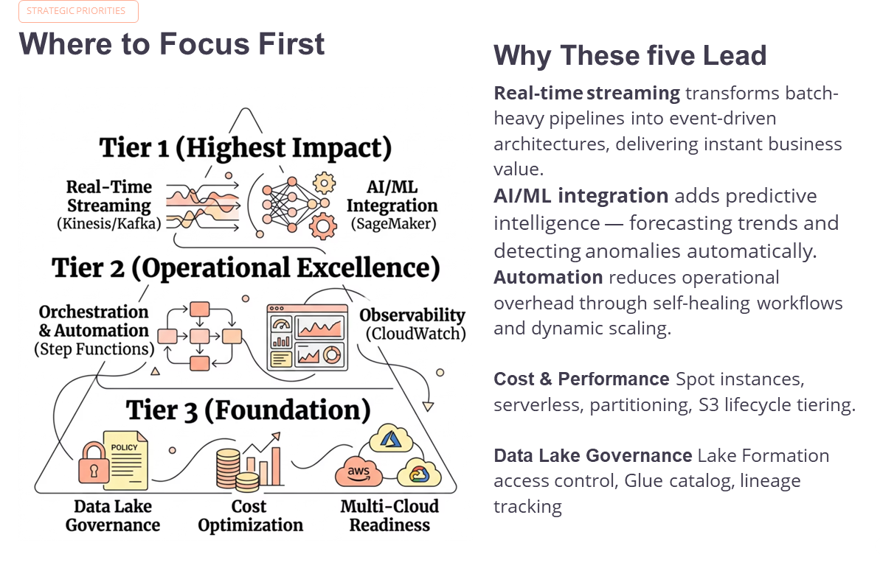

Slide 33
Suggestions and Feedback

Slide 34
Thank You

